Slide 1
Compiling C program
Manual Compilation

Slide 2
Variables
Scope
Global
Local
Lifetime
Automatic – allocated on the stack
Static - Allocated in the data segment
Dynamic - Allocated on the heap
Access
Private
Public

Slide 3
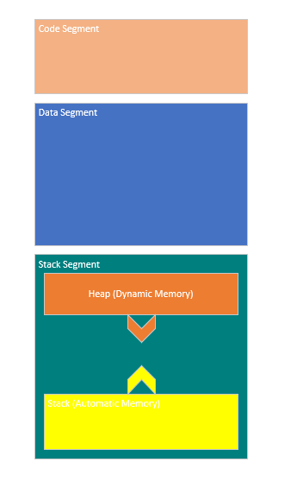
Program Memory

Slide 4
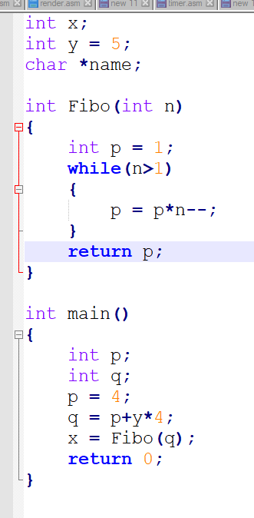
C Program
x,y Static and Global variables
p,q Local and automatic variables
name – global, pointer, static

Slide 5
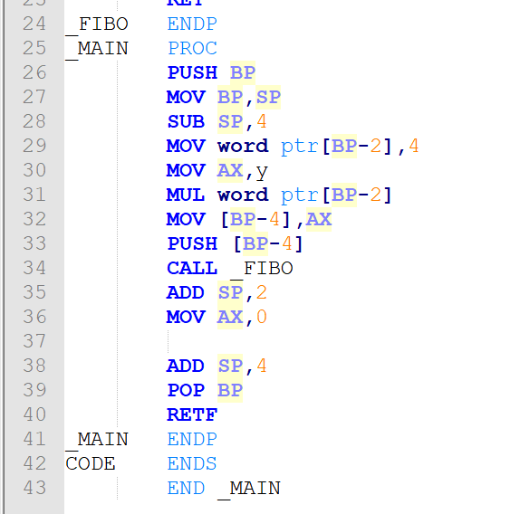
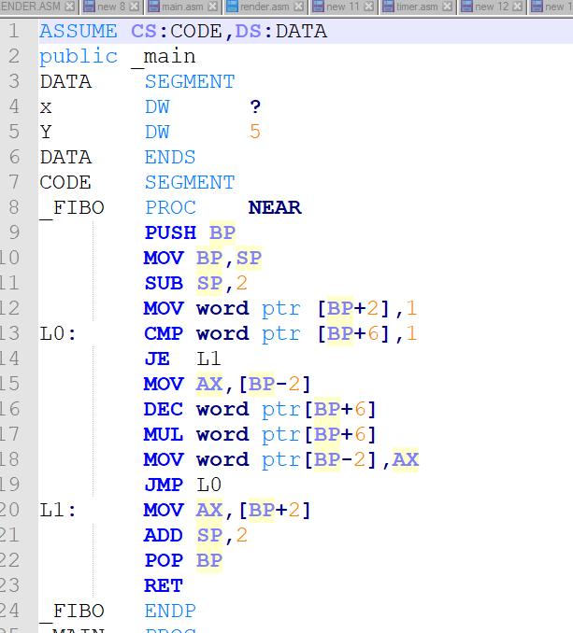
Assembly

Slide 6
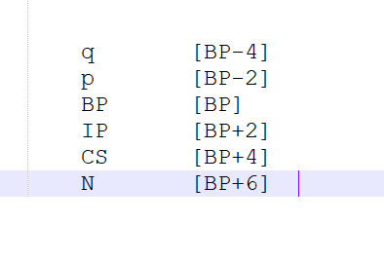
Stack content
Fibo Stack

Slide 7
Pocedure

